Slide 1

AI-BASED SMART INTERVIEW SYSTEM
FINAL REVIEW PRESENTATION
Project Guide - Vasanth V (TL & Software Engineer) Wittmann Battenfeld India Pvt Ltd
PRESENTED BY: NARESH KUMAR B
Unique Id -E0322008

Slide 2
ABSTRACT
AI-Based Smart Interview System is a completed web-based prototype for company-focused candidate screening and mock interview evaluation.
The final implementation includes OTP verification, resume upload and parsing, role selection, interview flow, answer submission, camera monitoring, result display, admin reports, and PDF report download.
The evaluation engine combines exact answer matching for objective questions with keyword matching, TF-IDF semantic similarity, and communication-quality scoring for descriptive answers.
OpenCV Haar Cascade face detection is integrated for face presence, centering, stability, and multiple-face alerts during the interview.
PostgreSQL is used as the live database for roles, users, test links, question bank, assigned interview papers, answers, interview scores, shortlist status, and report paths.

Slide 3
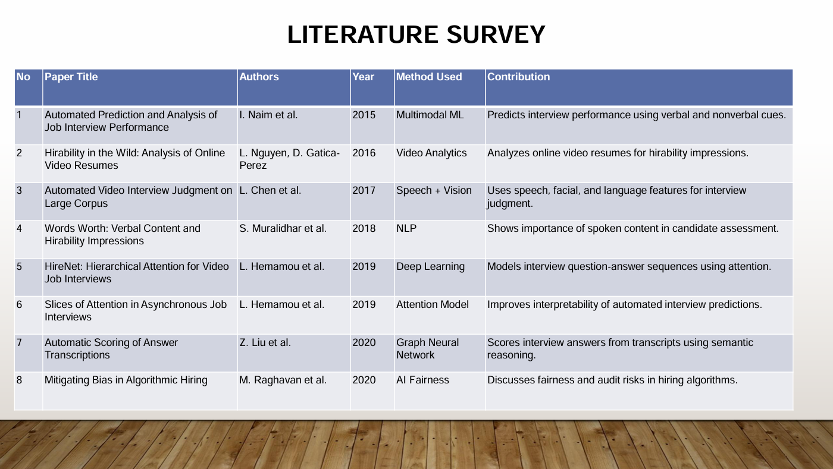

Slide 4
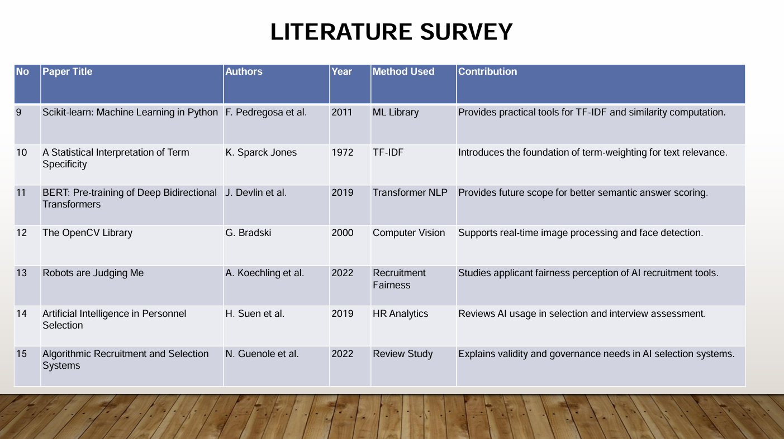

Slide 5
DETAILED DESIGN FOR FINAL SYSTEM
Candidate UI
OTP + Resume
Role Selection
Flask Backend
AI Evaluation
PostgreSQL DB
PDF Report
Admin Review
Candidate Interface -> Flask Routes -> Question Assignment -> NLP/OpenCV Evaluation -> Database + Report

Slide 6
FINAL SYSTEM: MODULES AND DATA FLOW
Frontend
Backend
AI / CV Layer
Database
Output
HTML/CSS/JS | Speech input | Camera stream | Result view
Flask routes | Session handling | OTP/test-link workflow | HTTPS/LAN support
Exact match | TF-IDF scoring | Keyword scoring | Face detection
roles | users | question_bank | interviews | interview_questions | candidate_answers
Overall score | Shortlist status | Admin reports | PDF download
Final design focus: every candidate receives a stored role-based question paper, so later question-bank edits do not change completed interview records.

Slide 7
CONTRIBUTION OF THE CANDIDATE (FINAL METHODOLOGY)
Collected requirements for a company-focused smart interview screening system.
Designed and implemented the complete workflow: candidate registration, OTP verification, resume upload, role selection, interview, evaluation, result, report download, and admin review.
Built Flask backend routes and connected scoring, database, question-bank, resume parsing, camera analysis, and report-generation modules.
Prepared role-wise aptitude and programming question-bank structure with PostgreSQL seed/import/sync scripts.
Integrated NLP scoring, exact answer scoring, OpenCV camera monitoring, shortlist decision logic, and PDF report generation.
Tested the complete demo flow on local/LAN HTTPS setup and prepared final-review documentation.

Slide 8
METHODOLOGY: FINAL EVALUATION LOGIC
Answer Submitted
Clean Text
Exact Match / Keyword + TF-IDF
Communication Score
Total Score + Shortlist Status
For aptitude and programming MCQ-style answers, exact answer matching is used.
For descriptive answers, total score = 35% keyword score + 45% semantic similarity + 20% communication score.
Face confidence is calculated from detected frames, centered frames, and stable frames.
Shortlist status is decided using interview score and proctoring/camera alert signals.

Slide 9
RESULTS OBTAINED (FINAL)
Candidate Flow
Question Bank
OTP/test link, resume upload, role selection, interview page, submit flow, result page.
PostgreSQL live question bank with role-wise random paper generation and assignment tracking.
AI Evaluation
Monitoring
Exact score, NLP score, keyword match, semantic score, communication score, feedback, and overall result.
Face detected / missing / multiple-face alerts using OpenCV frame analysis.
Reporting
Admin View
PDF candidate report with score, confidence index, shortlist status, reason, and feedback.
Admin database view, report listing, resume download, and candidate review support.

Slide 10
FINAL OUTPUT AND PROJECT STATUS
100%
Completed work: candidate flow, OTP/test link workflow, resume handling, role-wise interview, PostgreSQL question bank, stored question papers, answer scoring, OpenCV monitoring, shortlist logic, admin review, and PDF reporting.
The Flask application runs as a working prototype with candidate and admin screens.
Question bank storage is PostgreSQL-backed and editable without changing completed interview records.
Final implementation completed for project review
Generated reports and uploaded resumes are stored inside the project reports folder for later review.

Slide 11
FINAL CODE IMPLEMENTATION SNAPSHOTS - FLASK WORKFLOW
app.py - interview, stored paper, and submit flow
@app.route("/interview")
def interview():
interview_id = session.get("interview_id")
create_interview(interview_id, session["user_id"], session["role_id"])
questions = select_questions_for_role(role_slug)
save_interview_questions(interview_id, questions)
session["face_stats"] = {"total_frames": 0,
"detected_frames": 0, "stable_frames": 0}
return render_template("interview.html", questions=questions)
@app.route("/api/submit", methods=["POST"])
def submit_interview():
questions = load_interview_questions(session["interview_id"])
results = [score_answer(answer, question) for question, answer in submitted_answers]
report_path = generate_pdf_report(candidate_name, results, face_summary, REPORT_DIR)
complete_interview(interview_id, overall, report_path, shortlist_status, shortlist_reason)

Slide 12
FINAL CODE IMPLEMENTATION SNAPSHOTS - NLP SCORING
utils/scoring.py - scoring formula
def score_answer(answer, question):
if question.get("category") in {"Aptitude", "Programming"}:
exact = exact_answer_score(answer, question["correct_answer"])
return {"total_score": round(exact * 100, 2)}
kw = keyword_score(answer, question.get("keywords", []))
sem = semantic_score(answer, question.get("ideal_answer", ""))
comm = communication_score(answer)
total = (kw * 0.35) + (sem * 0.45) + (comm * 0.20)
return {"keyword_score": round(kw*100,2),
"semantic_score": round(sem*100,2),
"communication_score": round(comm*100,2),
"total_score": round(total*100,2)}

Slide 13
FINAL CODE IMPLEMENTATION SNAPSHOTS - POSTGRESQL QUESTION BANK
utils/question_bank.py and utils/database.py - editable live question bank
CREATE TABLE IF NOT EXISTS question_bank (
question_id SERIAL PRIMARY KEY,
question_code TEXT UNIQUE,
role_slug TEXT NOT NULL,
section TEXT NOT NULL,
topic TEXT NOT NULL,
difficulty TEXT NOT NULL DEFAULT 'Medium',
question_text TEXT NOT NULL,
options JSONB NOT NULL DEFAULT '[]'::jsonb,
correct_answer TEXT NOT NULL,
keywords JSONB NOT NULL DEFAULT '[]'::jsonb,
marks INTEGER NOT NULL DEFAULT 5,
active BOOLEAN NOT NULL DEFAULT TRUE,
assignment_count INTEGER NOT NULL DEFAULT 0,
last_assigned_at TIMESTAMPTZ
);

Slide 14
FINAL CODE IMPLEMENTATION SNAPSHOTS - CAMERA MONITORING
static/js/interview.js and app.py - OpenCV face monitoring flow
async function analyzeCameraFrame() {
const response = await fetch('/api/analyze-frame', {
method: 'POST',
headers: {'Content-Type': 'application/json'},
body: JSON.stringify({image: canvas.toDataURL('image/jpeg')})
});
const data = await response.json();
if (data.face_detected) faceStatus.innerText = 'Face detected';
if (data.multiple_faces) triggerAlarm(data.alert_reason);
}
# Flask endpoint uses OpenCV Haar Cascade
faces = face_cascade.detectMultiScale(gray, 1.2, 5,
minSize=(60, 60))

Slide 15
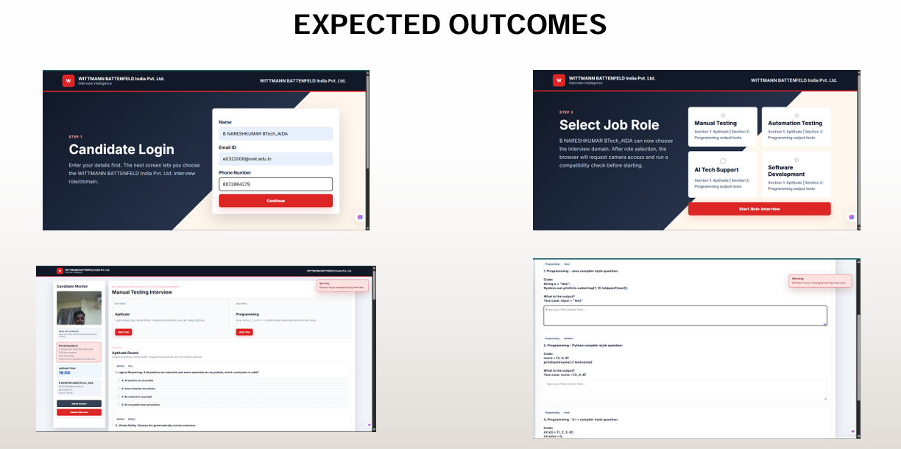
OUTPUT RESULT
Final validation confirms that the prototype is ready for academic demonstration and future production enhancement.

Slide 16
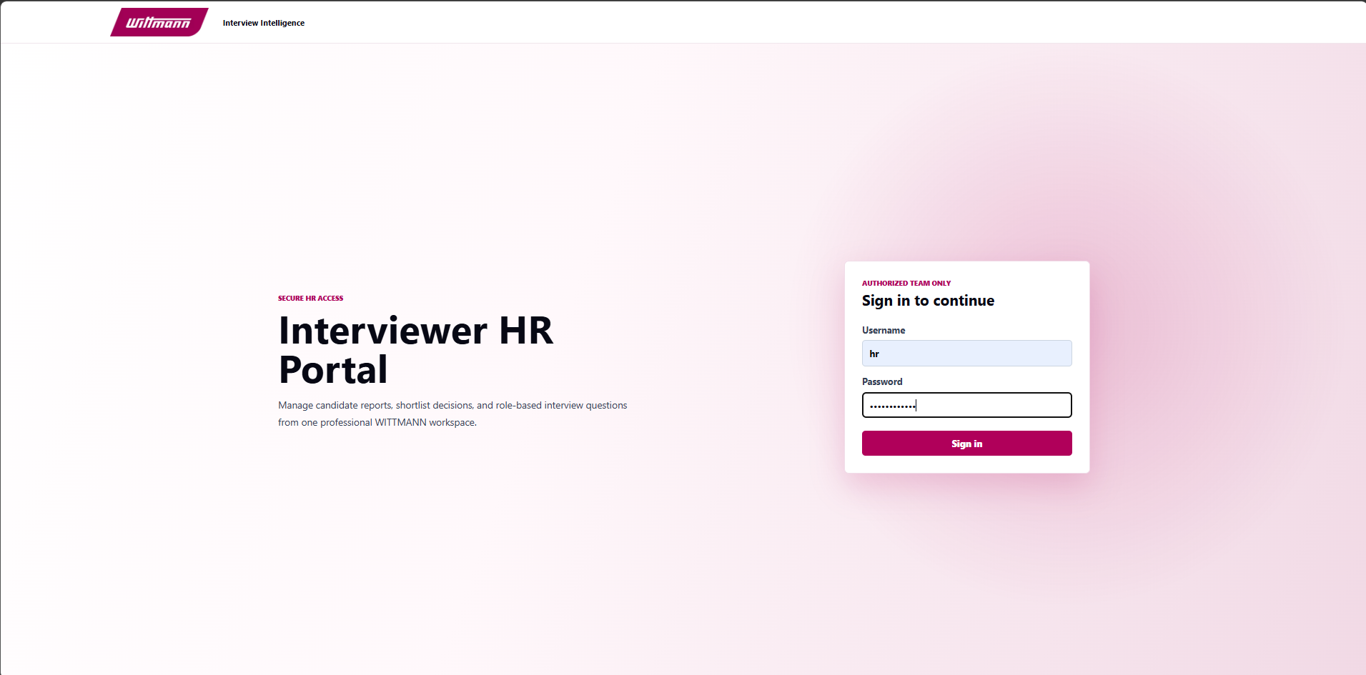
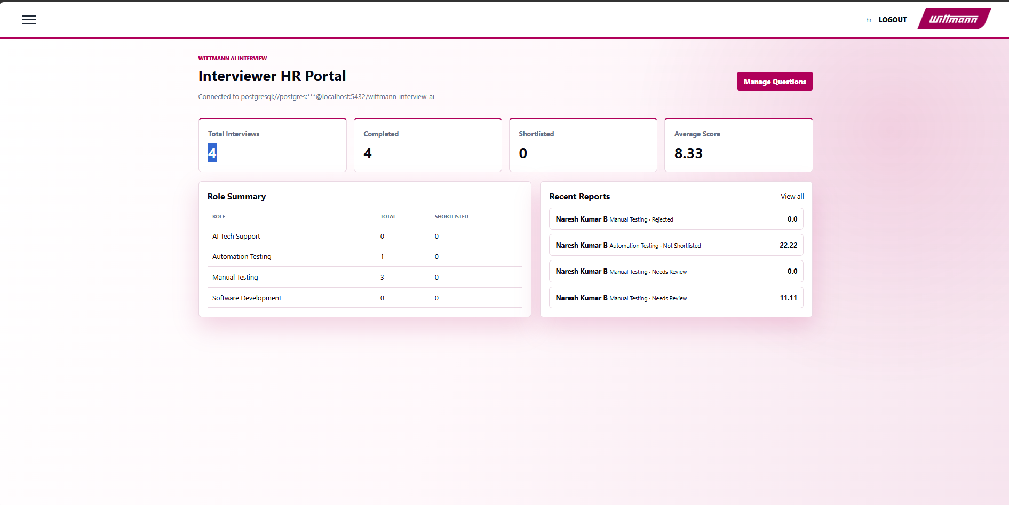
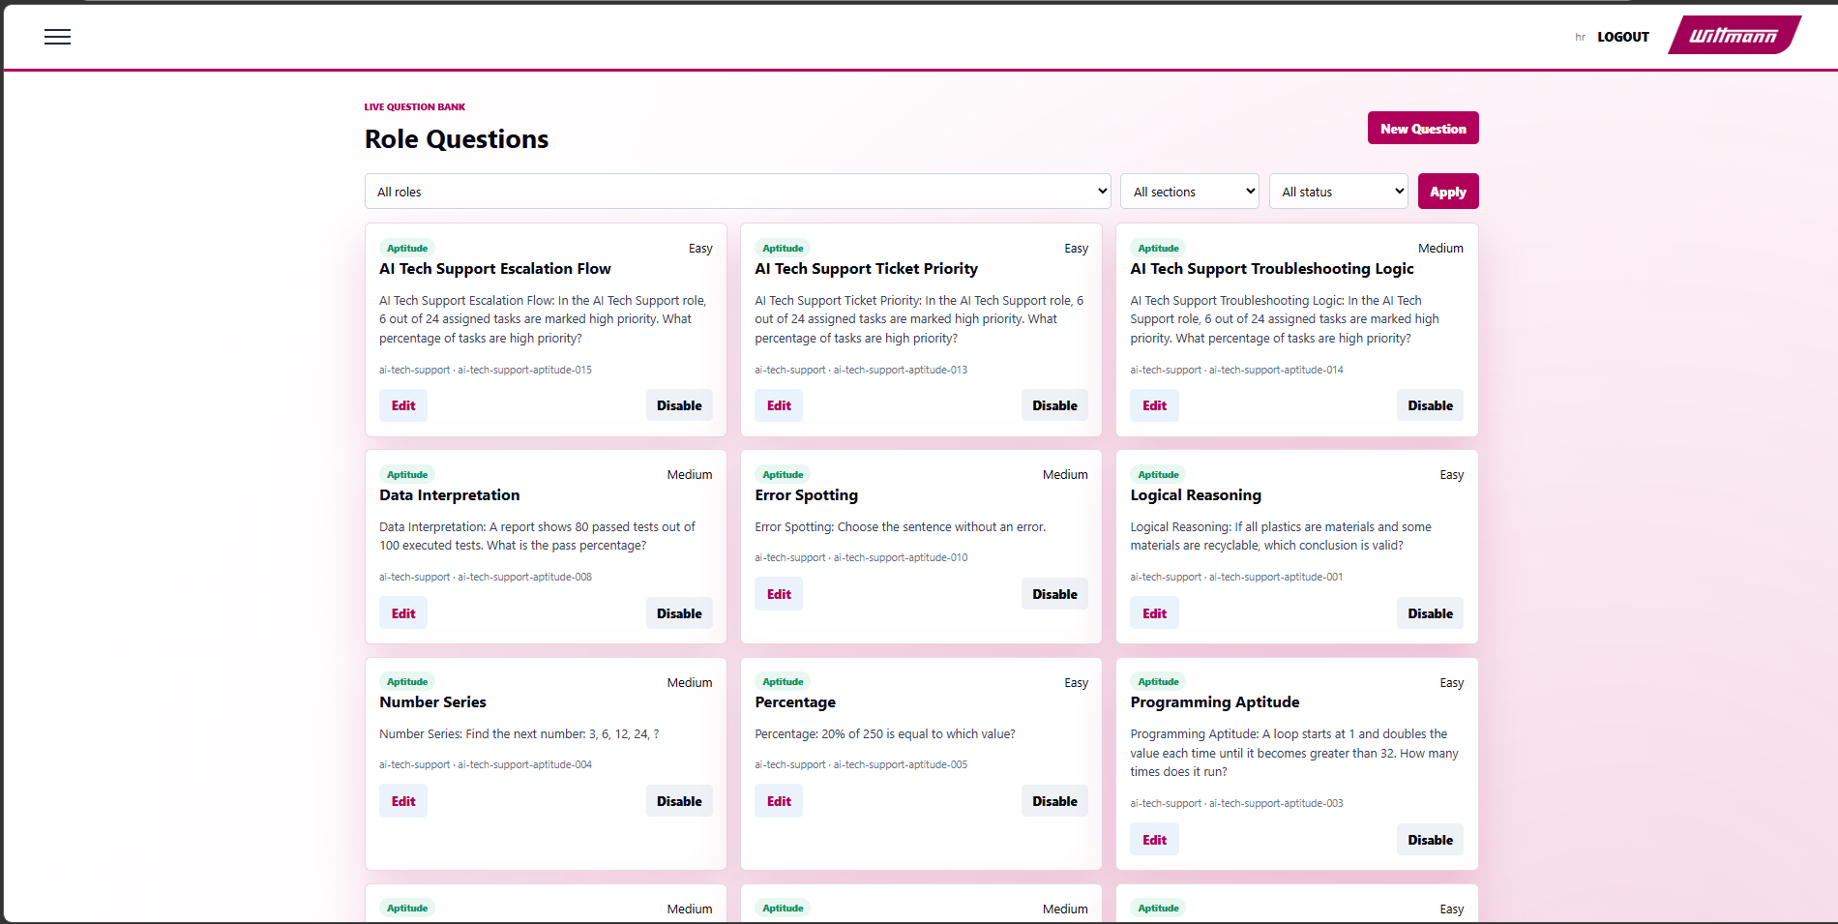
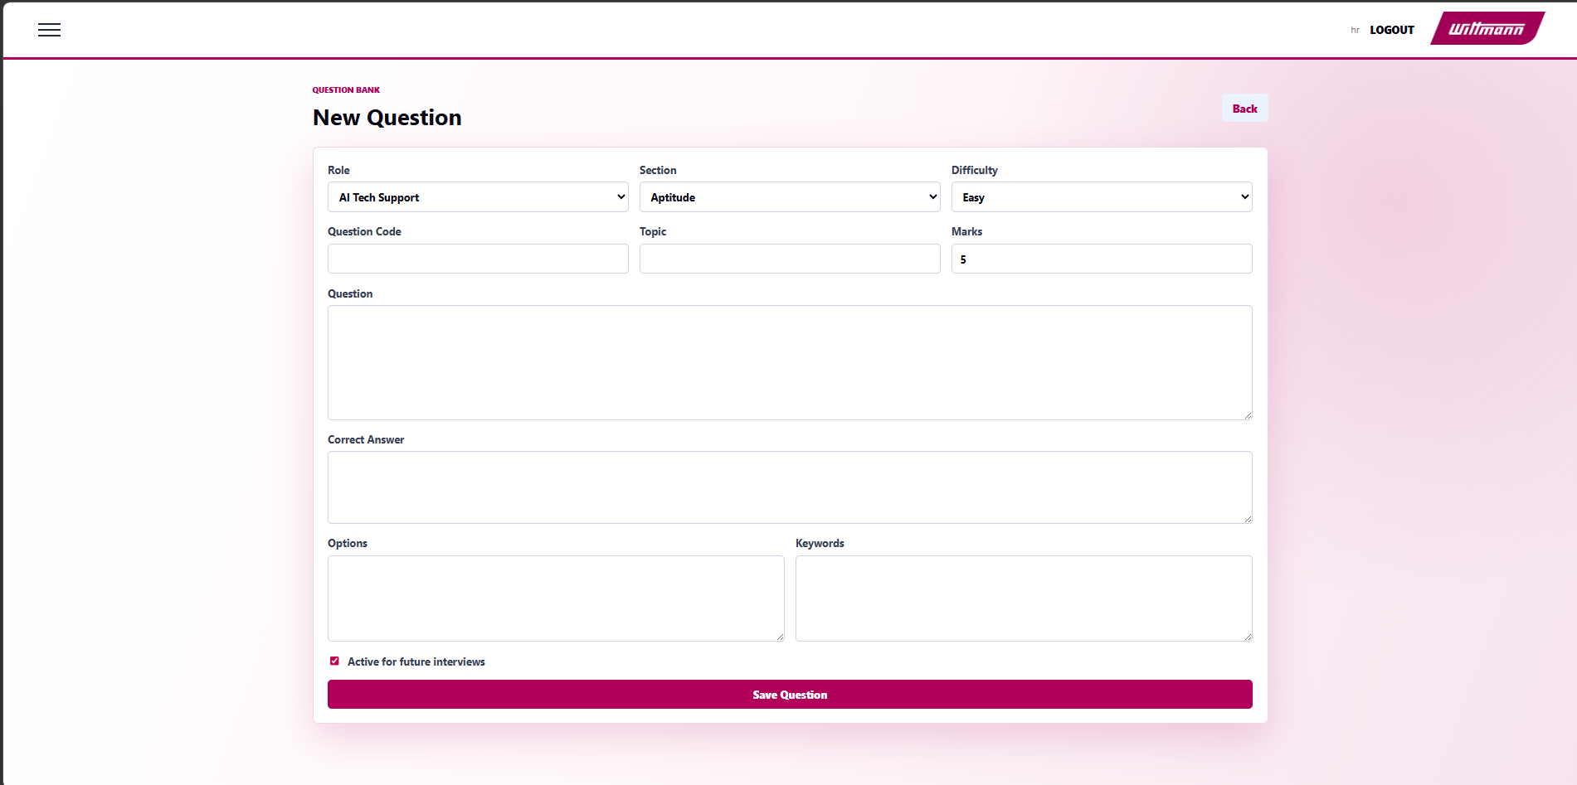
OUTPUT RESULT
Final validation confirms that the prototype is ready for academic demonstration and future production enhancement.

Slide 17
REFERENCES
I. Naim et al., "Automated Prediction and Analysis of Job Interview Performance", 2015.
L. Nguyen and D. Gatica-Perez, "Hirability in the Wild: Analysis of Online Video Resumes", 2016.
L. Chen et al., "Automated Video Interview Judgment on Large Corpus", 2017.
F. Pedregosa et al., "Scikit-learn: Machine Learning in Python", 2011.
K. Sparck Jones, "A Statistical Interpretation of Term Specificity", 1972.
G. Bradski, "The OpenCV Library", 2000.
J. Devlin et al., "BERT: Pre-training of Deep Bidirectional Transformers", 2019.
H. Suen et al., "Artificial Intelligence in Personnel Selection", 2019.
Flask, PostgreSQL, ReportLab, OpenCV, and scikit-learn official documentation.

Slide 18
THANK YOU
AI-Based Smart Interview System | Final Review

